Slide 1
ChatGPT: Journey Through an LLM
Sam Scott, Mohawk College, June 2023

Slide 2
Reminder: The Core Task of ChatGPT
Given a text prompt, predict the natural language token (word) that comes next.
ChatGPT is a Large Language Model powered by a deep Artificial Neural Network architecture called a Transformer.

Slide 3
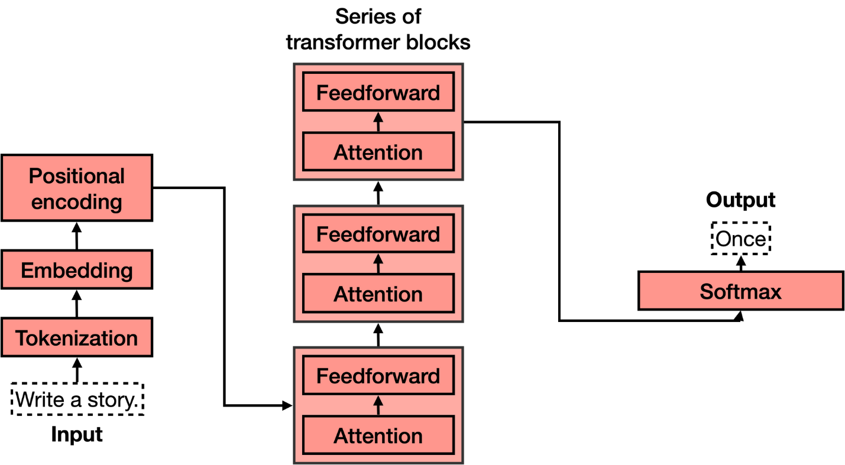
The Journey …
Reverse Embedding
Adapted from https://txt.cohere.com/what-are-transformer-models

Slide 4
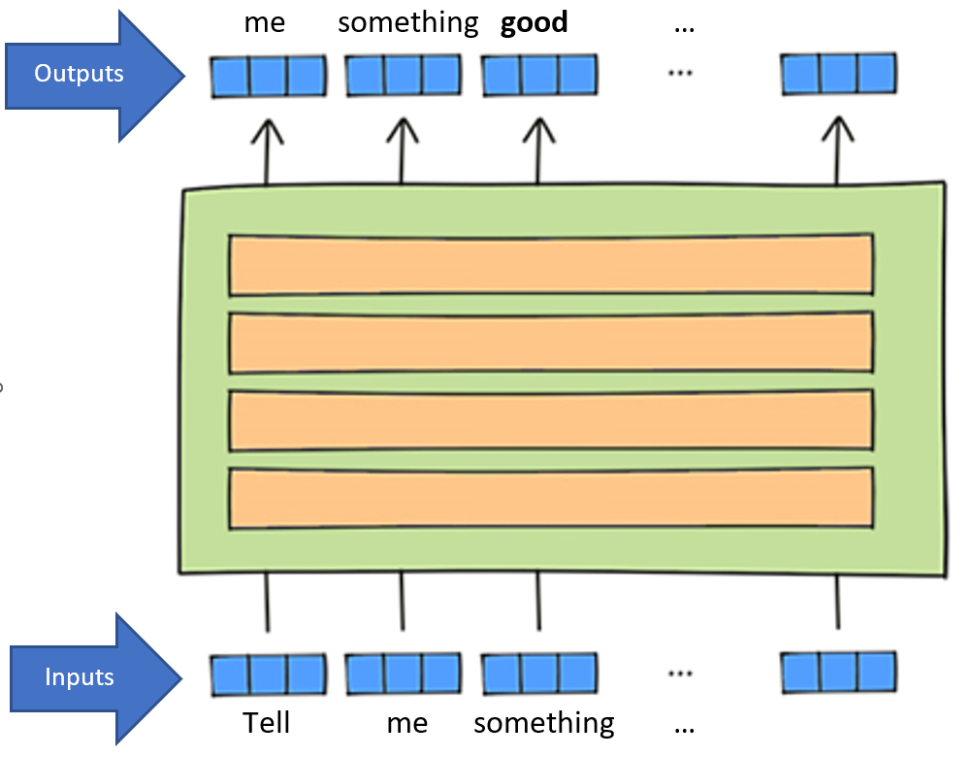
A 1000-foot View
Tokens are converted to vectors (lists of numbers)
All the tokens are fed in at the same time.
2048 x 50000 = 102 400 000 inputs & outputs
Artificial Neural Networks
(mostly)
Adapted from https://www.lavivienpost.com/how-chatgpt-works-architecture-illustrated/

Slide 5
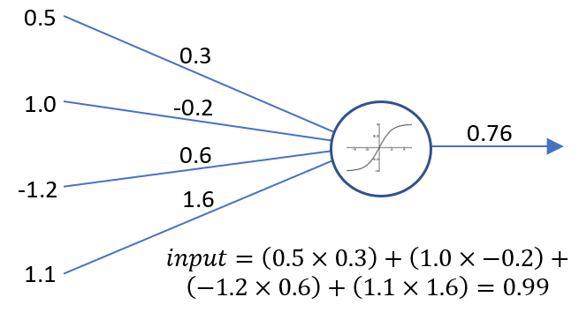
What is an Artificial Neural Network?
It’s a bunch of simple calculation devices (artificial neurons) all hooked up together.
It’s a way of turning one set of numbers into another set of numbers.
Here’s an artificial neuron
output
inputs
weights
activation function
Input = 0.5 x 0.3 + 1.0 x (-0.2) + (-1.2) x 0.6
+ 1.1 x 1.6 = 0.99

Slide 6
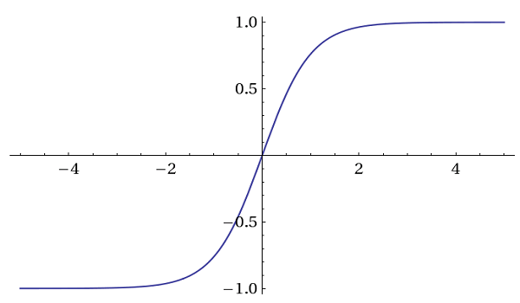
What is an Artificial Neural Network?
It’s a bunch of simple calculation devices (artificial neurons) all hooked up together.
It’s a way of turning one set of numbers into another set of numbers.
Here’s its Activation Function
input
output
Output = tanh(0.99) = 0.76

Slide 7
What is an Artificial Neural Network?
It’s a bunch of simple calculation devices (artificial neurons) all hooked up together.
It’s a way of turning one set of numbers into another set of numbers.
Here’s an artificial neuron
output
inputs
weights
activation function
Input = 0.5 x 0.3 + 1.0 x (-0.2) + (-1.2) x 0.6
+ 1.1 x 1.6 = 0.99

Slide 8
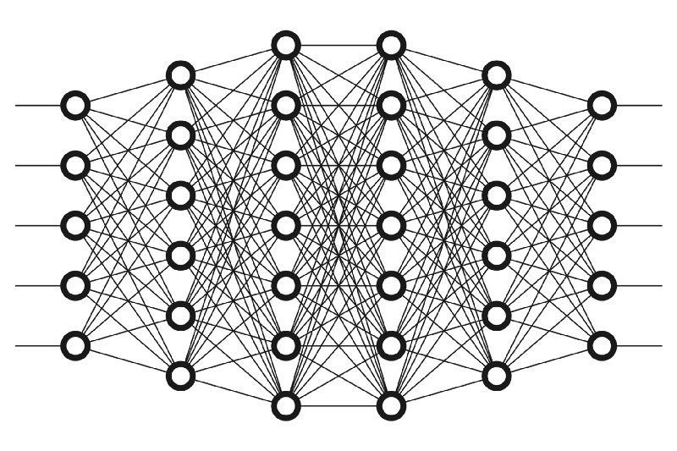
What is an Artificial Neural Network?
It’s a bunch of simple calculation devices (artificial neurons) all hooked up together.
It’s a way of turning one set of numbers into another set of numbers.
Here’s an artificial neural network
Weights = Parameters (175 Billion)
Learning = Adjusting Parameters
inputs
outputs
weights
weights
https://www.freecodecamp.org/

Slide 9
What is an Artificial Neural Network?
It’s a bunch of simple calculation devices (artificial neurons) all hooked up together.
It’s a way of turning one set of numbers into another set of numbers.
Training an artificial neuron
I got 0.76 but I wanted 0.
So, change the weights a little bit.
0.25
output
tanh(0.99)
tanh(0.635)
inputs
-0.3
0.56
0.7
1.5
Change!
Input = 0.5 x 0.25 + 1.0 x (-0.3) + (-1.2) x 0.7
+ 1.1 x 1.5 = 0.635
Input = 0.5 x 0.3 + 1.0 x (-0.2) + (-1.2) x 0.6
+ 1.1 x 1.6 = 0.99
(Note the 5th bias weight is not shown)

Slide 10
What is an Artificial Neural Network?
It’s a bunch of simple calculation devices (artificial neurons) all hooked up together.
It’s a way of turning one set of numbers into another set of numbers.
Training an artificial neural network
inputs
outputs
First , fix the output layer weights
“Backpropagate” to fix the rest
Then these
Then these
Then these
Fix these first
Then these
https://www.freecodecamp.org/

Slide 11
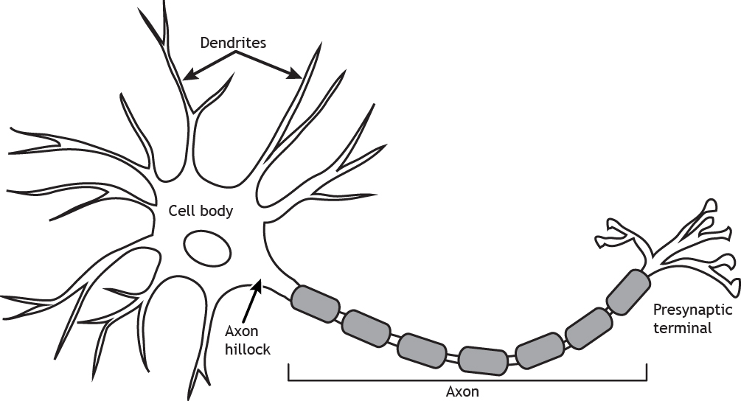
What is an Artificial Neural Network?
It’s a bunch of simple calculation devices (artificial neurons) all hooked up together.
It’s a way of turning one set of numbers into another set of numbers.
Here’s a real neuron (artist’s depiction)
inputs
Weights?
output
https://openbooks.lib.msu.edu/neuroscience/

Slide 12
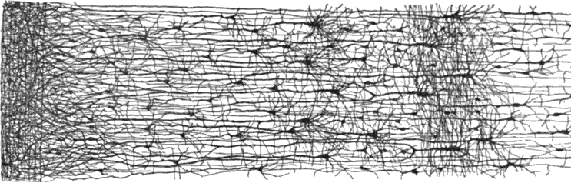
What is an Artificial Neural Network?
It’s a bunch of simple calculation devices (artificial neurons) all hooked up together.
It’s a way of turning one set of numbers into another set of numbers.
Here’s a real neural network (detail)
Learning?
https://www.oreilly.com/

Slide 13
A 1000-foot View of a GPT Model
Tokens are converted to vectors (lists of numbers)
All the tokens are fed in at the same time.
2048 x 50000 = 102 400 000 inputs & outputs
Artificial Neural Networks
(mostly)
Adapted from https://www.lavivienpost.com/how-chatgpt-works-architecture-illustrated/

Slide 14
Starting the Journey
next
next
Reverse Embedding
Diagram adapted from https://txt.cohere.com/what-are-transformer-models

Slide 15
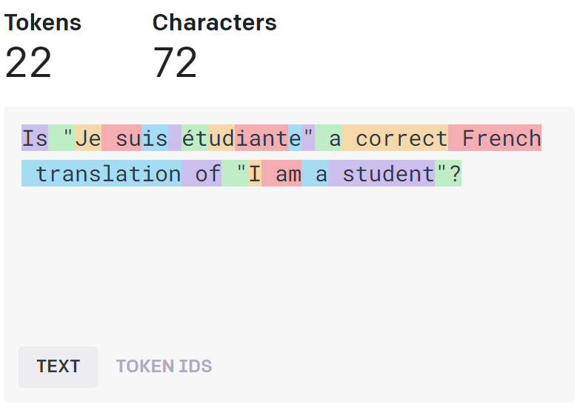
Tokenization: Text to Tokens
https://platform.openai.com/tokenizer
Token: word, part of word, punctuation, etc…
Vocabulary: set of tokens the LLM “knows”
Tokenization: splitting up input into tokens

Slide 16
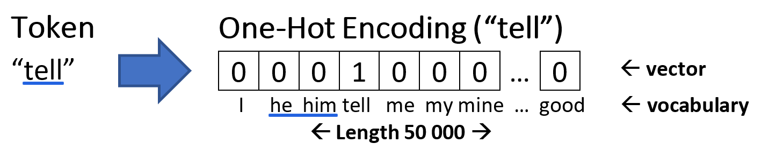
Tokens to One-hot Encodings

Slide 17
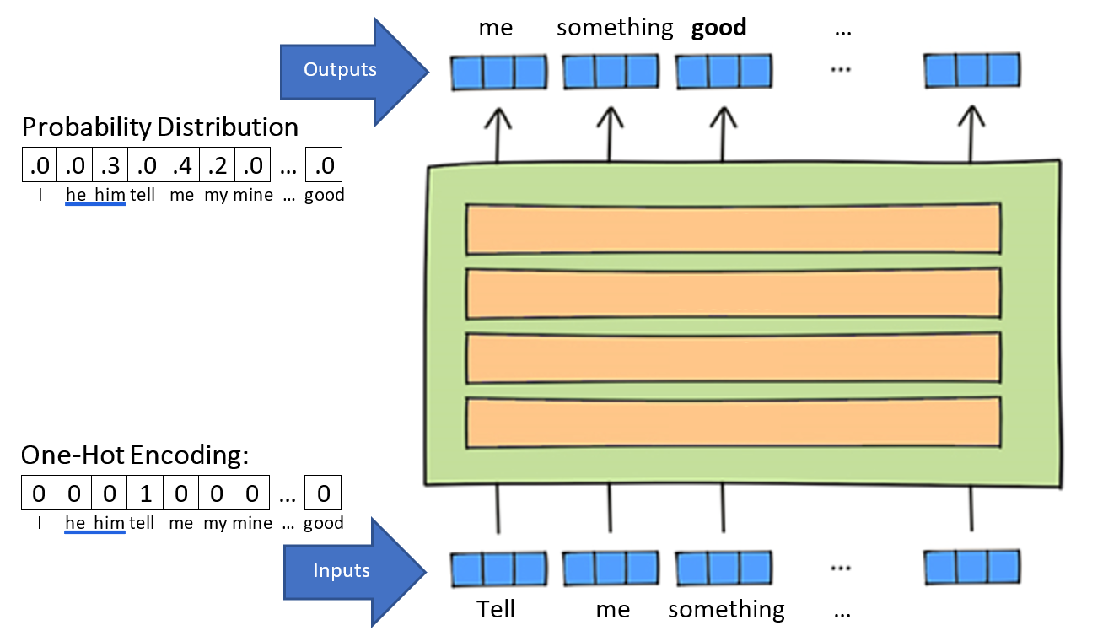
Back to the 1000-foot View
ChatGPT predicts a next token for every token in the prompt.
But the process is messy, so we get a probability distribution.
Usually, we’re only interested in the final token prediction.
Artificial Neural Networks
(mostly)
Adapted from https://www.lavivienpost.com/how-chatgpt-works-architecture-illustrated/

Slide 18
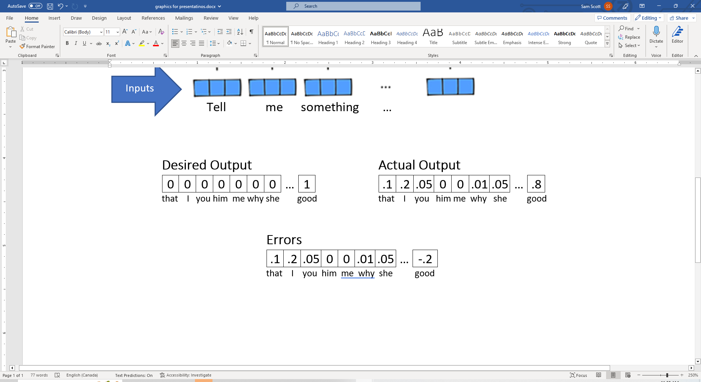

A Note on Training
In training, we can compare the probability distribution we get for each word to the one-hot encoding for the actual next word.
This “Error Signal” is then used to tune the weights (parameters) of the artificial neurons that produced the output.

Slide 19
The Journey So Far
next
Reverse Embedding
next
Diagram adapted from https://txt.cohere.com/what-are-transformer-models

Slide 20
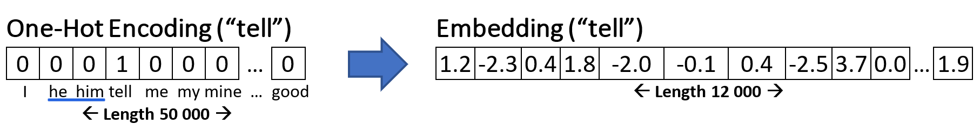
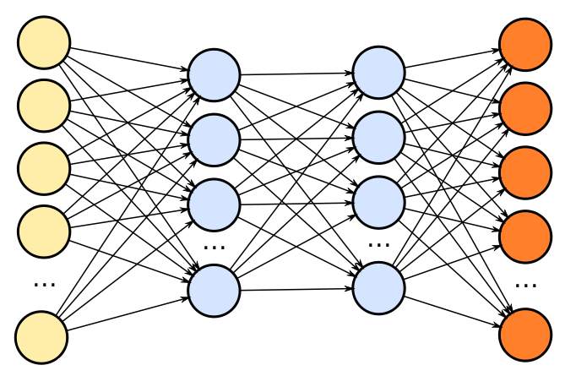
One-hot Encodings → Embeddings
Embedding: “small”, information-rich token vectors.
Embeddings are computed by an Artificial Neural Network.

Slide 21
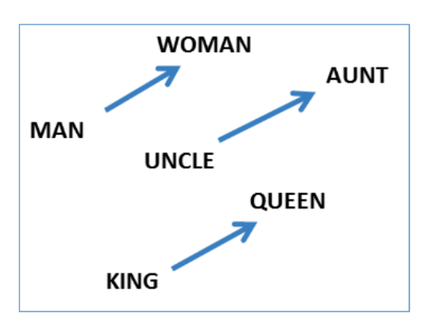
What’s in an Embedding?
Embeddings encode distribution patterns for words.
E.g., the embeddings for “cat” and “dog” will be more similar than “cat” and “tickle”.
dog
cat
tickle

Slide 22
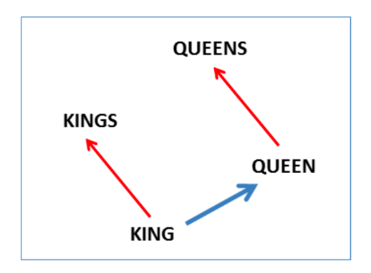
What’s in an Embedding?
Embeddings are very hard to interpret.
But researchers have shown consistent relationships between embeddings.
Embeddings are what allows the transformer to generalize.

Slide 23
Embeddings get Transformed
Transformed Embeddings
Transformations
Mostly via Artificial Neural Networks
Embeddings
Adapted from https://www.lavivienpost.com/how-chatgpt-works-architecture-illustrated/

Slide 24
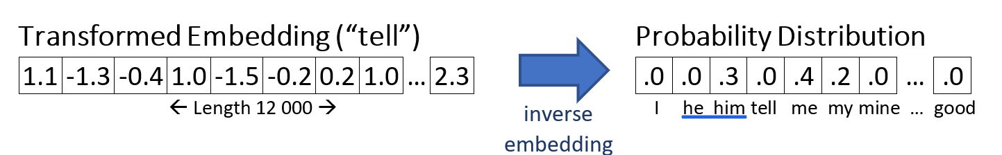
Transformed Embeddings are Decoded
transformations

Slide 25
The Journey So Far
next
Reverse Embedding
Diagram adapted from https://txt.cohere.com/what-are-transformer-models

Slide 26
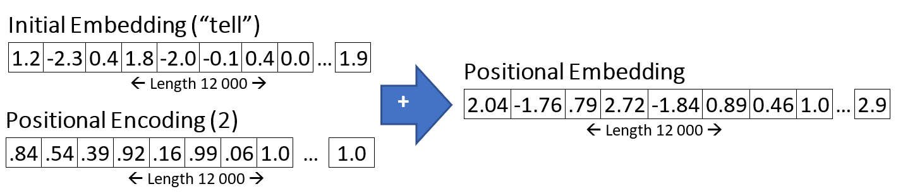
Positional Encoding
Word position is important!
“Please tell the poker players.” vs “Every poker player has a tell.”
Every embedding has a positional encoding added to it.
Positional encoding is different for each position.

Slide 27
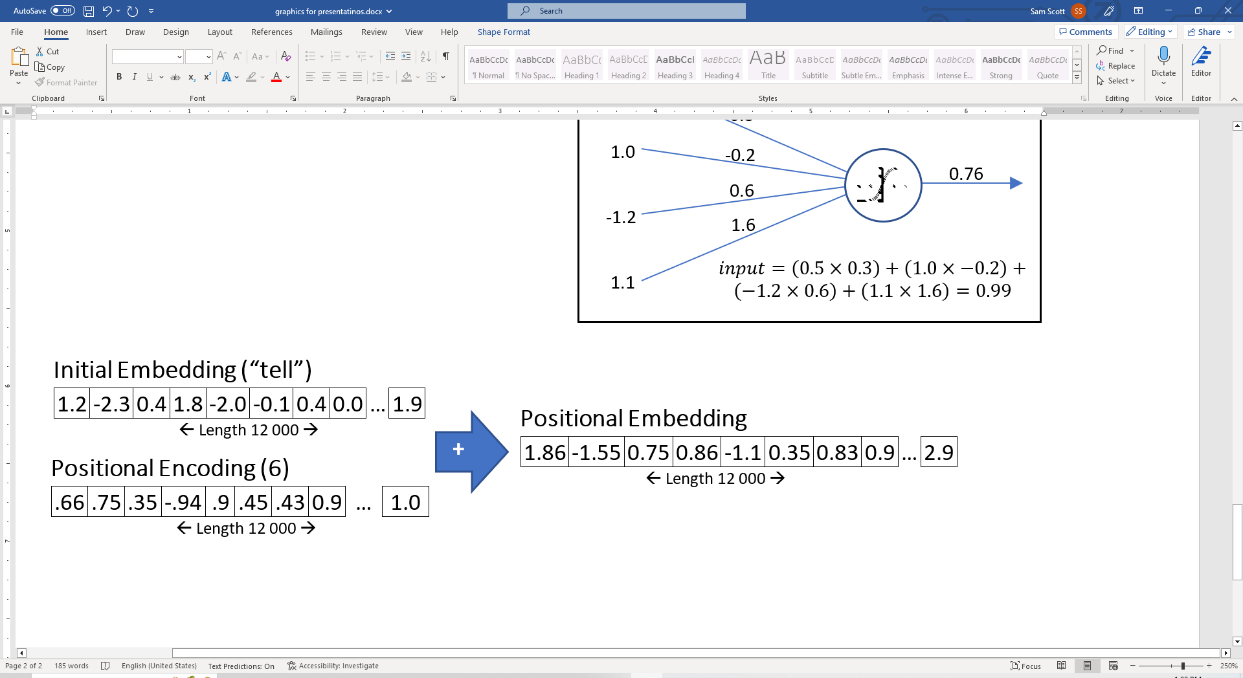
Positional Encoding
Word position is important!
“Please tell the poker players.” vs “Every poker player has a tell.”
Every embedding has a positional encoding added to it.
Positional encoding is different for each position.

Slide 28
Why Does this Work?
Somebody had a hunch and it worked out.
🤷

Slide 29
The Journey So Far
Reverse Embedding
Transformer Block
next
Diagram adapted from https://txt.cohere.com/what-are-transformer-models

Slide 30
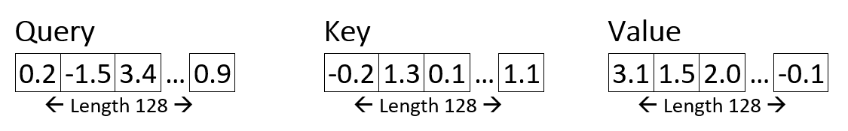
The Attention Mechanism
96 x

Slide 31
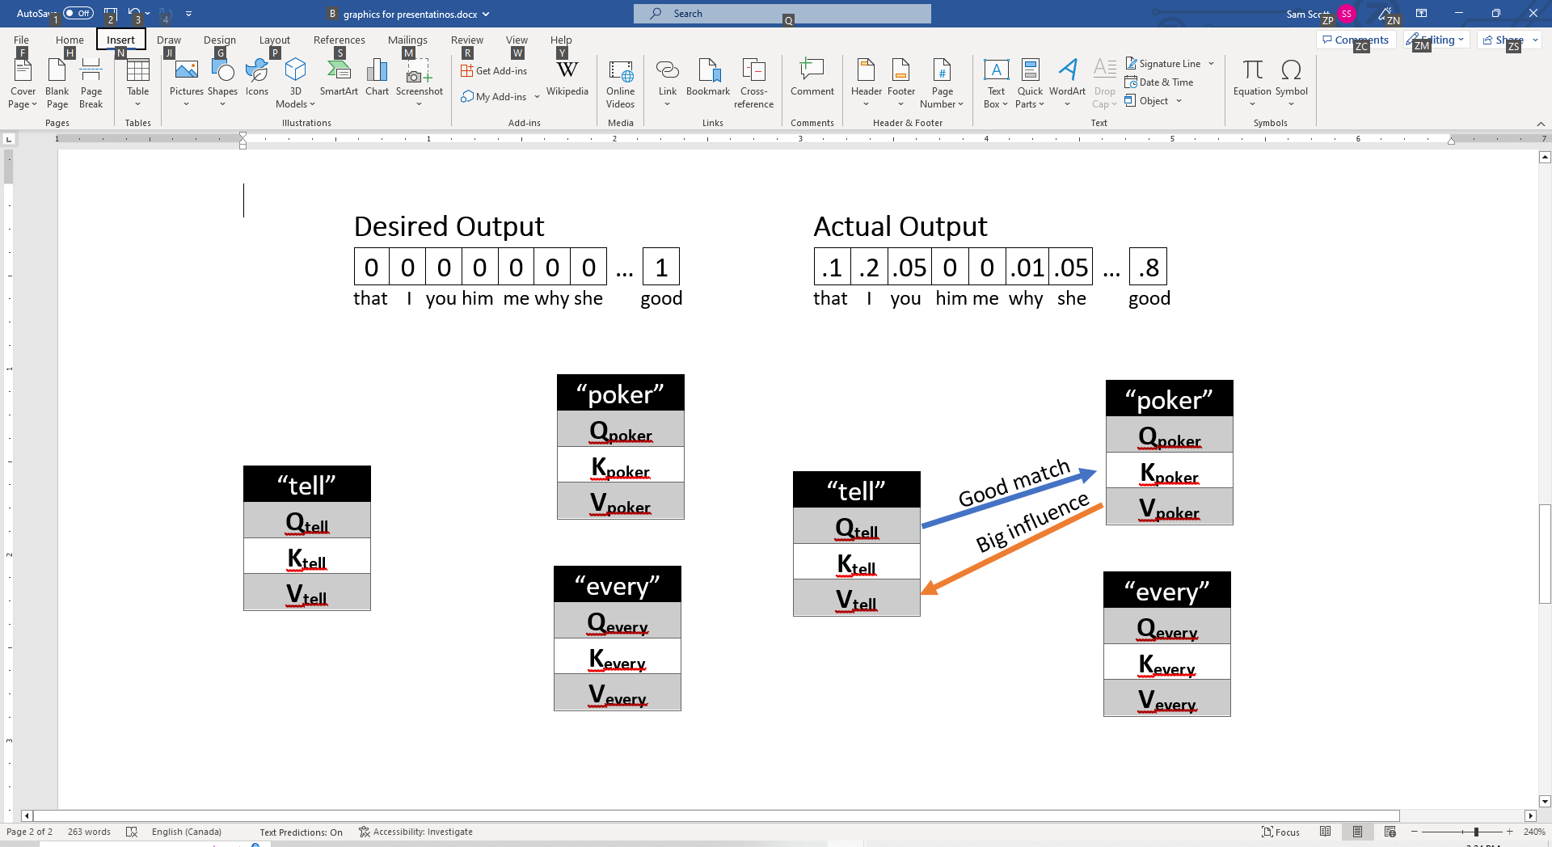
Relevant Context Words Combined
Tokens: Every poker player has a tell .
Query is compared to each preceding token’s Key.
The Values of good matches are combined.

Slide 32
Relevant Context Words Combined
Tokens: Every poker player has a tell .
Query is compared to each preceding token’s Key.
The Values of good matches are combined.

Slide 33
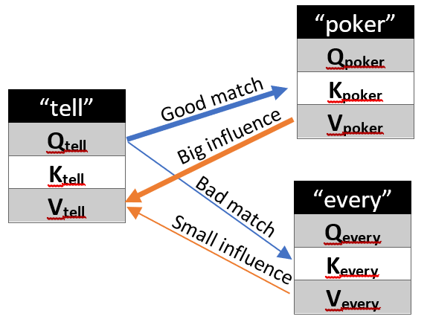
Relevant Context is Added
Tokens: Every poker player has a tell .
Query is compared to each preceding token’s Key.
The Values of good matches are combined.
X 96

Slide 34

Final Values are Concatenated
Value₁, Value₂, Value₃, …, Value₉₆ = New Embedding Vector!
“Tell” → 96 combined value vectors
→ value vector length = 128
→ 96 x 128 $≅$ 12 000
Now “tell” has a new, contextualized, embedding

Slide 35
The Journey So Far
next
Reverse Embedding
Transformer Block
Diagram adapted from https://txt.cohere.com/what-are-transformer-models

Slide 36
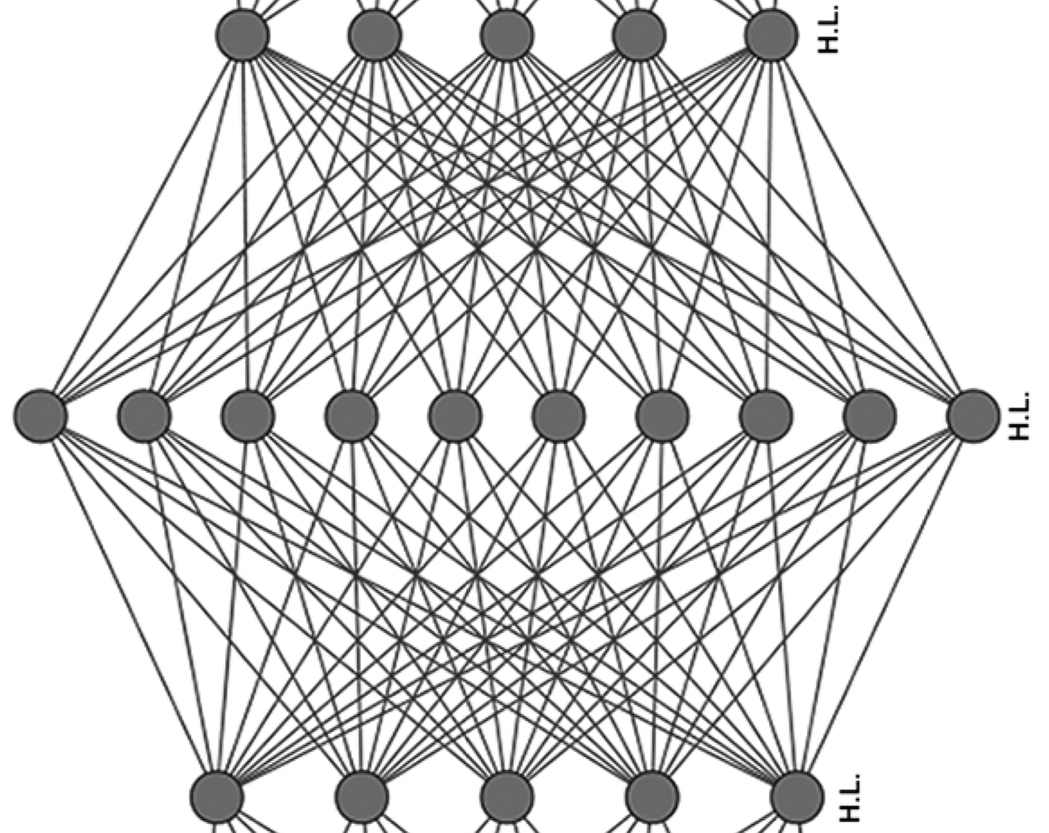
The Feedforward Layer
Feedforward = Neural Network Layer
Transforms the embeddings again but doesn’t change their length.
Even More
Transformed Embedding
Transformed Embedding

Slide 37
The Transformer Blocks are Repeated
next
Transformer Block
Reverse Embedding
Diagram adapted from https://txt.cohere.com/what-are-transformer-models

Slide 38
The Transformer Blocks are Repeated
next
Transformer Block
Reverse Embedding
Diagram adapted from https://txt.cohere.com/what-are-transformer-models

Slide 39
And That’s the Whole Journey!
Reverse Embedding
Diagram adapted from https://txt.cohere.com/what-are-transformer-models

Slide 40
Recap from 1000 Feet
Reverse Embedding
Attention
Positional Encoding
Embedding
Adapted from https://www.lavivienpost.com/how-chatgpt-works-architecture-illustrated/

Slide 41
What We Know and Don’t Know
ChatGPT is predicting the next token based on a generalized context.
It’s processes thousands of words in parallel.
Tokens are represented as vectors of numbers.
Each vector gets transformed into a prediction.
Sometimes ChatGPT “hallucinates”. Can this be solved?
Is ChatGPT thinking or reasoning?
🤷
What would William of Okham say?

Slide 42
Up Next…
→Training and Fine-Tuning
→The Discovery of Prompt Engineering
→Social, Ethical, Cognitive Implications

